Slide 1

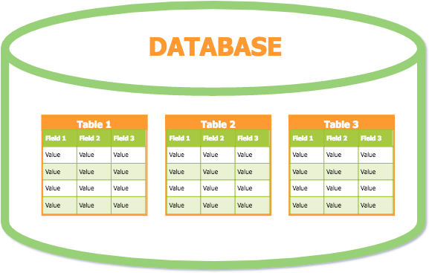
Databases
Lesson 5 Introduction to SQL

Slide 2
Structured Query Language (SQL)
The most widely used and the standard language for RDBMS.
A Declarative Language (Non procedural language) used to communicate with a database.
Expected result is given without specific details about how to accomplish the task.
Only need to specify what needs to be accomplished and not how to do it.
The DBMS determines and performs internally the step by
step operations needed to obtain the result.

Slide 3
SQL Statements
Instructions are given in the form of statements, consisting of a specific SQL command and additional parameters that apply to that statement.
Commonly used statements are grouped into the following categories:
Data Definition Language (DDL)
Data Manipulation Language (DML)
Data Control Language (DCL)
Data Query Language (DQL)

Slide 4
Data Definition Language (DDL)
Used to define the database structure (Physical Design).
CREATE
Create new objects (table, view, etc) in the database.
ALTER
Modify the structure of existing objects in the database.
DROP
Remove (delete) objects from the database.

Slide 5
Data Manipulation Language (DML)
Change the data in the database.
INSERT
Insert data into a table
UPDATE
Updates existing data within a table
DELETE
Deletes certain records from a table

Slide 6
Data Query Language (DQL)
Retrieve certain records from one or more tables.
SELECT - Retrieve data from the database

Slide 7
Data Control Language (DCL)
Control the access of the data in the database and determines how, when, and whom can manipulate data.
Provide commands to specify access rights to tables and views.
GRANT
Give access privilege to someone to the database.
REVOKE
Take back/ withdraw access privileges granted to someone.

Slide 8
Data Control Language (DCL)
COMMIT
Permanently save the work done (transactions) into the DB.
SAVEPOINT
Temporally save a transaction so that we can rollback to that point whenever necessary.
ROLLBACK
Restore database to original since the last COMMIT or SAVEPOINT

Slide 9
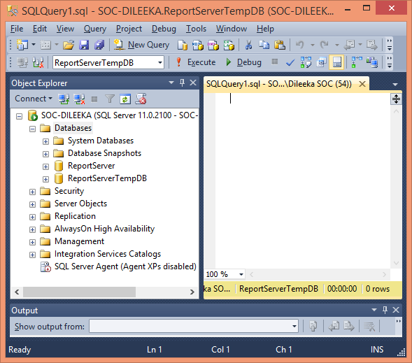
MS SQL Server

Slide 10
Create a Database
CREATE DATABASE <Database_Name>
Exercise:
– Create a database to save details about the office activities.
10

Slide 11
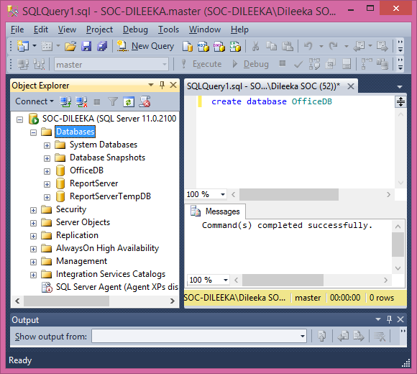

Slide 12

Delete a Database
DROP DATABASE
<Database_Name>
Exercise:
– Delete the OfficeDB that you have created earlier.
12

Slide 13
Create Tables
CREATE TABLE
(field_name1 field_name2
….
…. field_name
<table_name> data_type(field_size), data_type(field_size),
data_type(field_size)
)
No need to specify the field sizes for INTEGER and DATE data types.
13

Slide 14
Exercise
Create a table in the OfficeDB to save details about employees.
Fields of the table:
Employee ID
Employee Name
Address
DOB
Age
Contact no
NIC
14

Slide 15
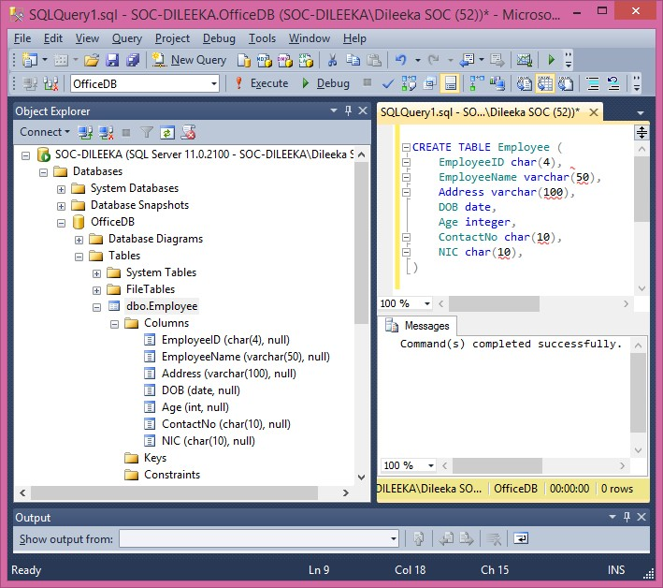

Slide 16
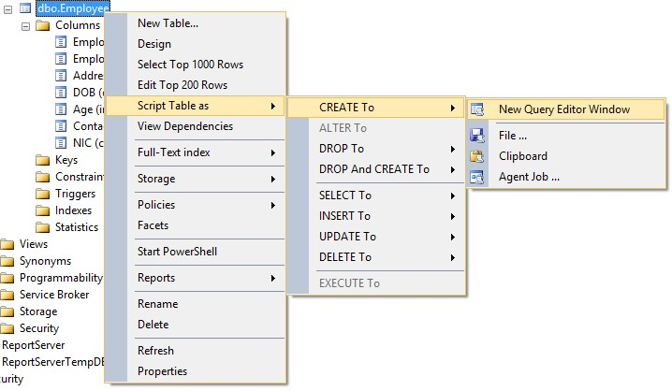

Slide 17
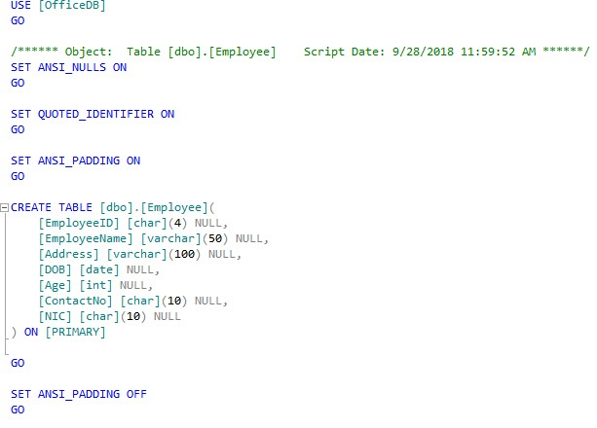

Slide 18
Insert Records to a Table
INSERT INTO <table_name> VALUES (… , …. , …..)
Exercise:
– Insert your details to Employee table.
18

Slide 19
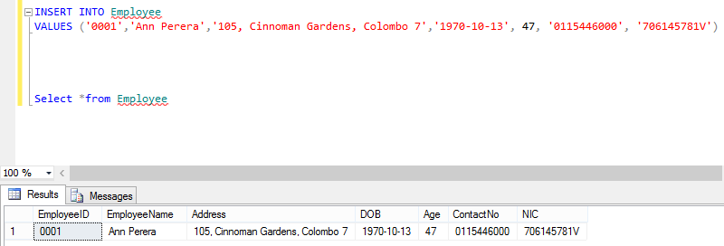
Insert Records

Slide 20
Insert Data to a Table
Insert data only to selected fields:
INSERT INTO <table_name> <field names to enter values> VALUES (… , …. , …..)
Exercise:
– Insert only Employee ID, Employee Name and ContactNo to
Employee table.
20

Slide 21
Insert Data to a Table
Insert data by changing the order of the fields:
Exercise:
– Insert only Employee ID, ContactNo, Age and Employee
Name to Employee table.
21

Slide 22
Update Records
UPDATE <table_name>
SET <field_name> = <New_attribute_domain>
WHERE <field_name> = <Searching_attribute_domain>
Exercise:
– Update the contact number of Employee 0001.
22

Slide 23
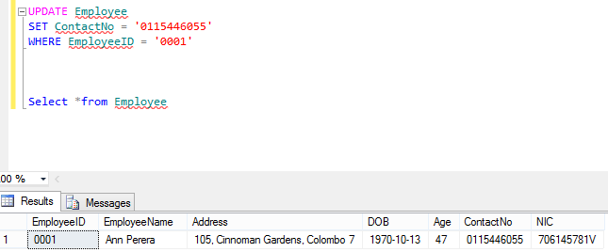
Update Records

Slide 24
Delete Records
DELETE FROM <table_name>
WHERE <field_name> = <Searching_attribute_domain>
Exercise:
– Delete your record from the Employee table.
24

Slide 25
Thank You

